Slide 1

High-Fi Prototype
Christos Tsagkaridis, Dimitris Dimitriadis, Chibu Agbanyim, Alyssa Nicole Doria

Slide 2
Introduction
The basic idea of exploreReading is to enable the exploration of the Berkshire are and inform the users about the attractions that it has to offer.
It provides pictures of each attraction and a brief description about it. A live map view is also available in order to inform about the location of each landmark.

Slide 3
Instructions
In order to explore the full potential of the website prototype:
Open the website
Click on the first picture
Then the bigger picture is shown with a description and a map
Read the description of the landmark
Interact with the live map

Slide 4
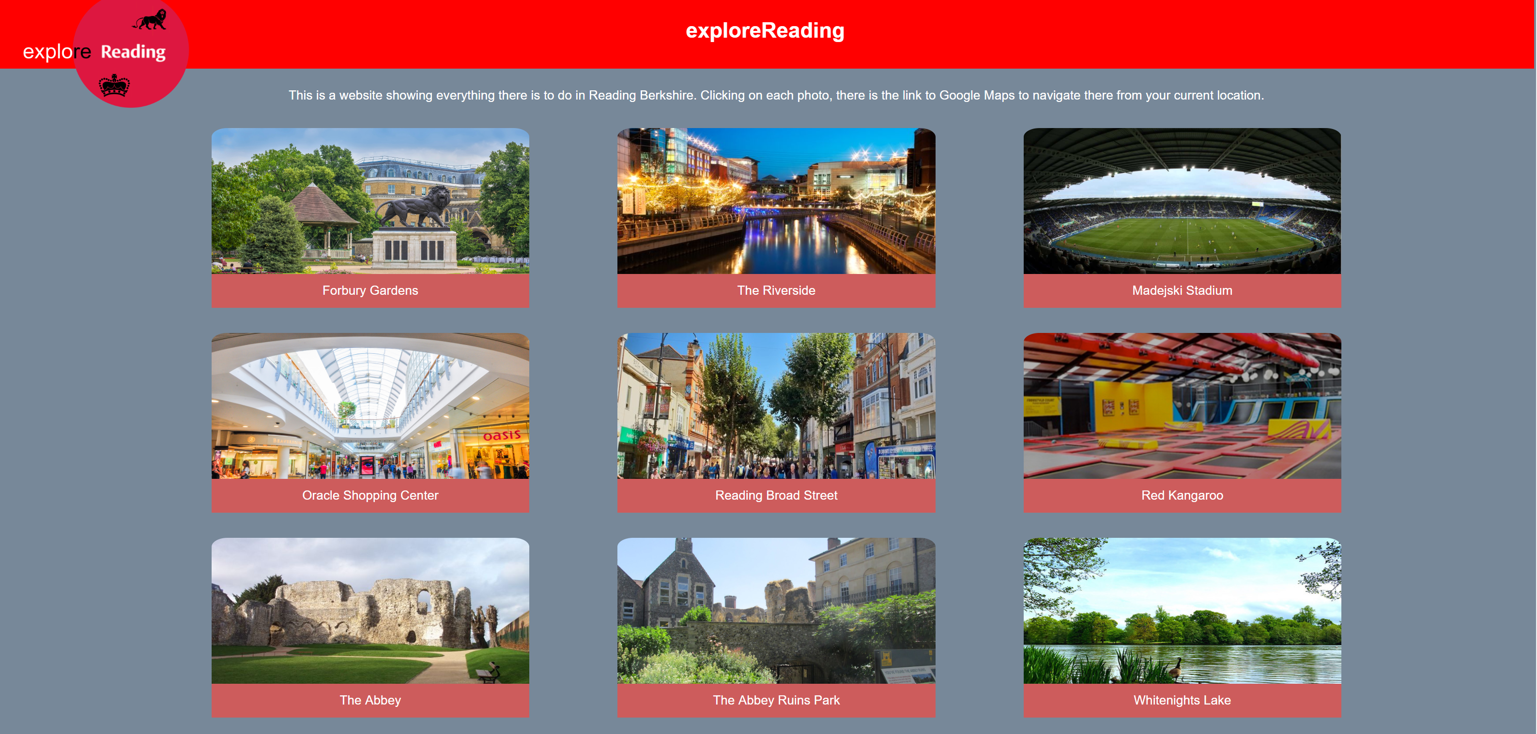
How to use
As it is shown in the screenshot this is the main page of the website illustrating all the attractions of the area.
The user can click on the pictures to see the relevant information about each landmark

Slide 5
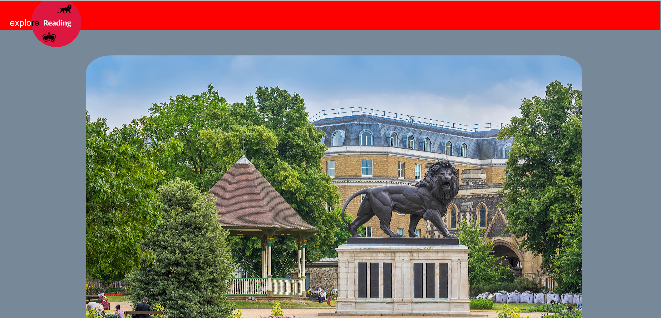
How to use
The screenshot shows an example of the page after the user clicks on one of the pictures of a landmark. Then a bigger picture appears in the screen to indicate the particular landmark.

Slide 6
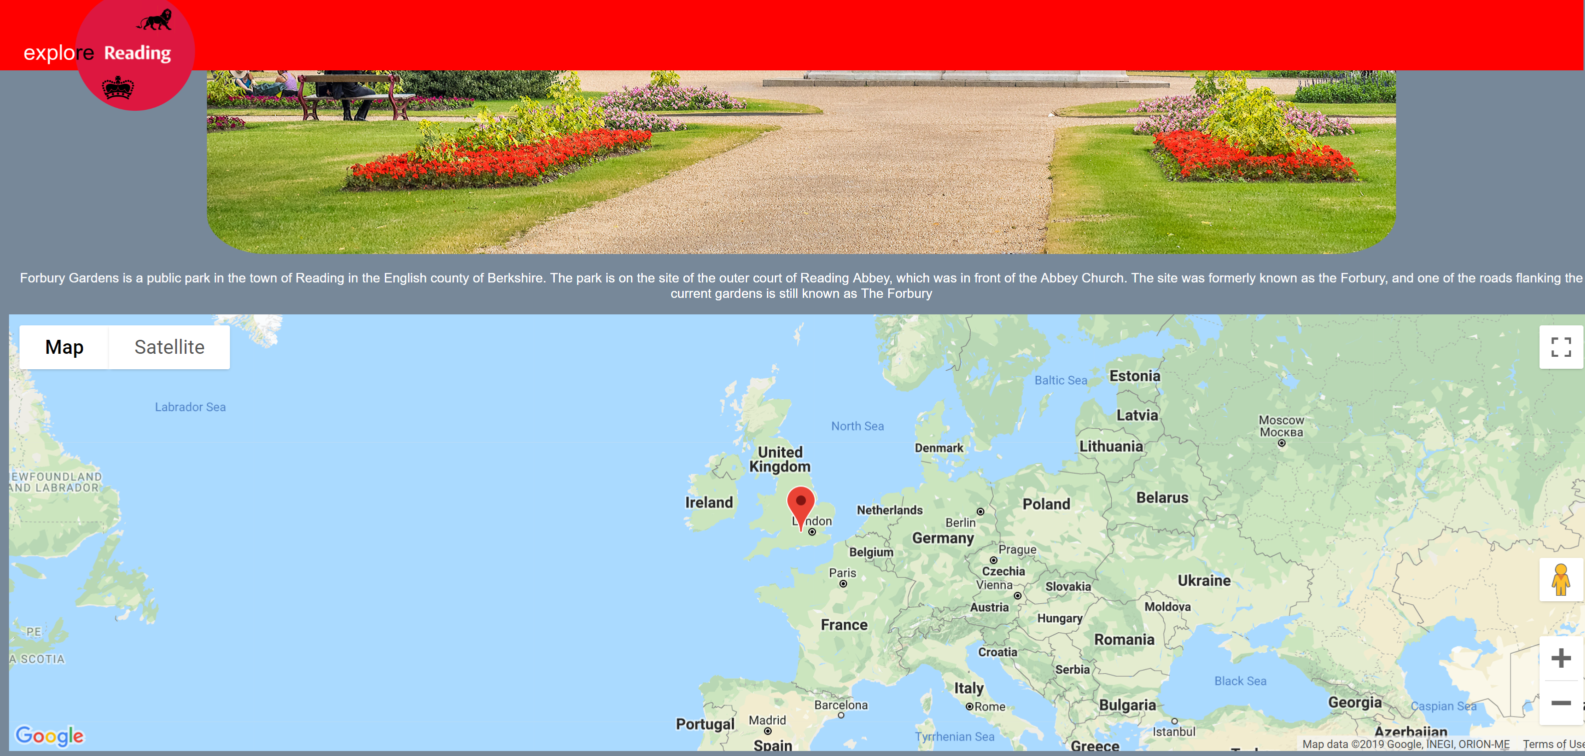
How to use
After the user scrolls down a brief description of each landmark appears and an interactive map showing the location of each landmark.
The user can click on the left top logo to go back to the main page

Slide 7
High-Fi Prototype Demo

